Slide 1
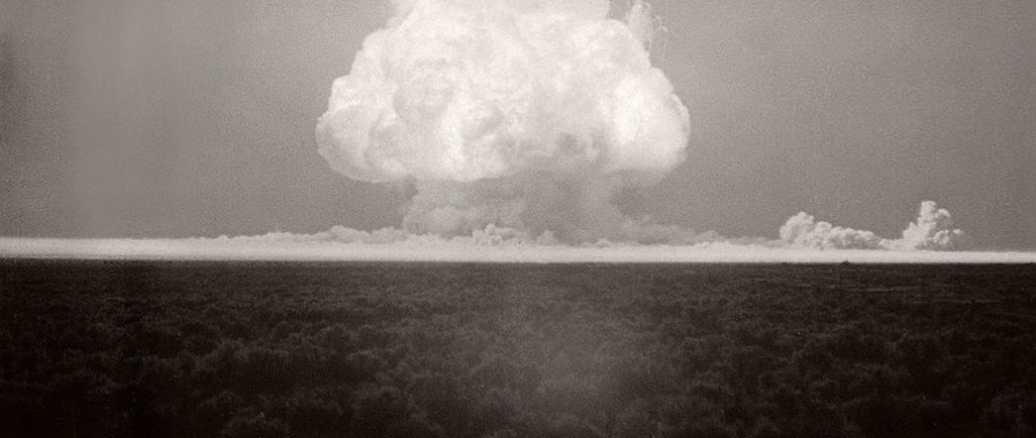
NUCLEAR ENERGY
By- Tanishq Maurya

Slide 2
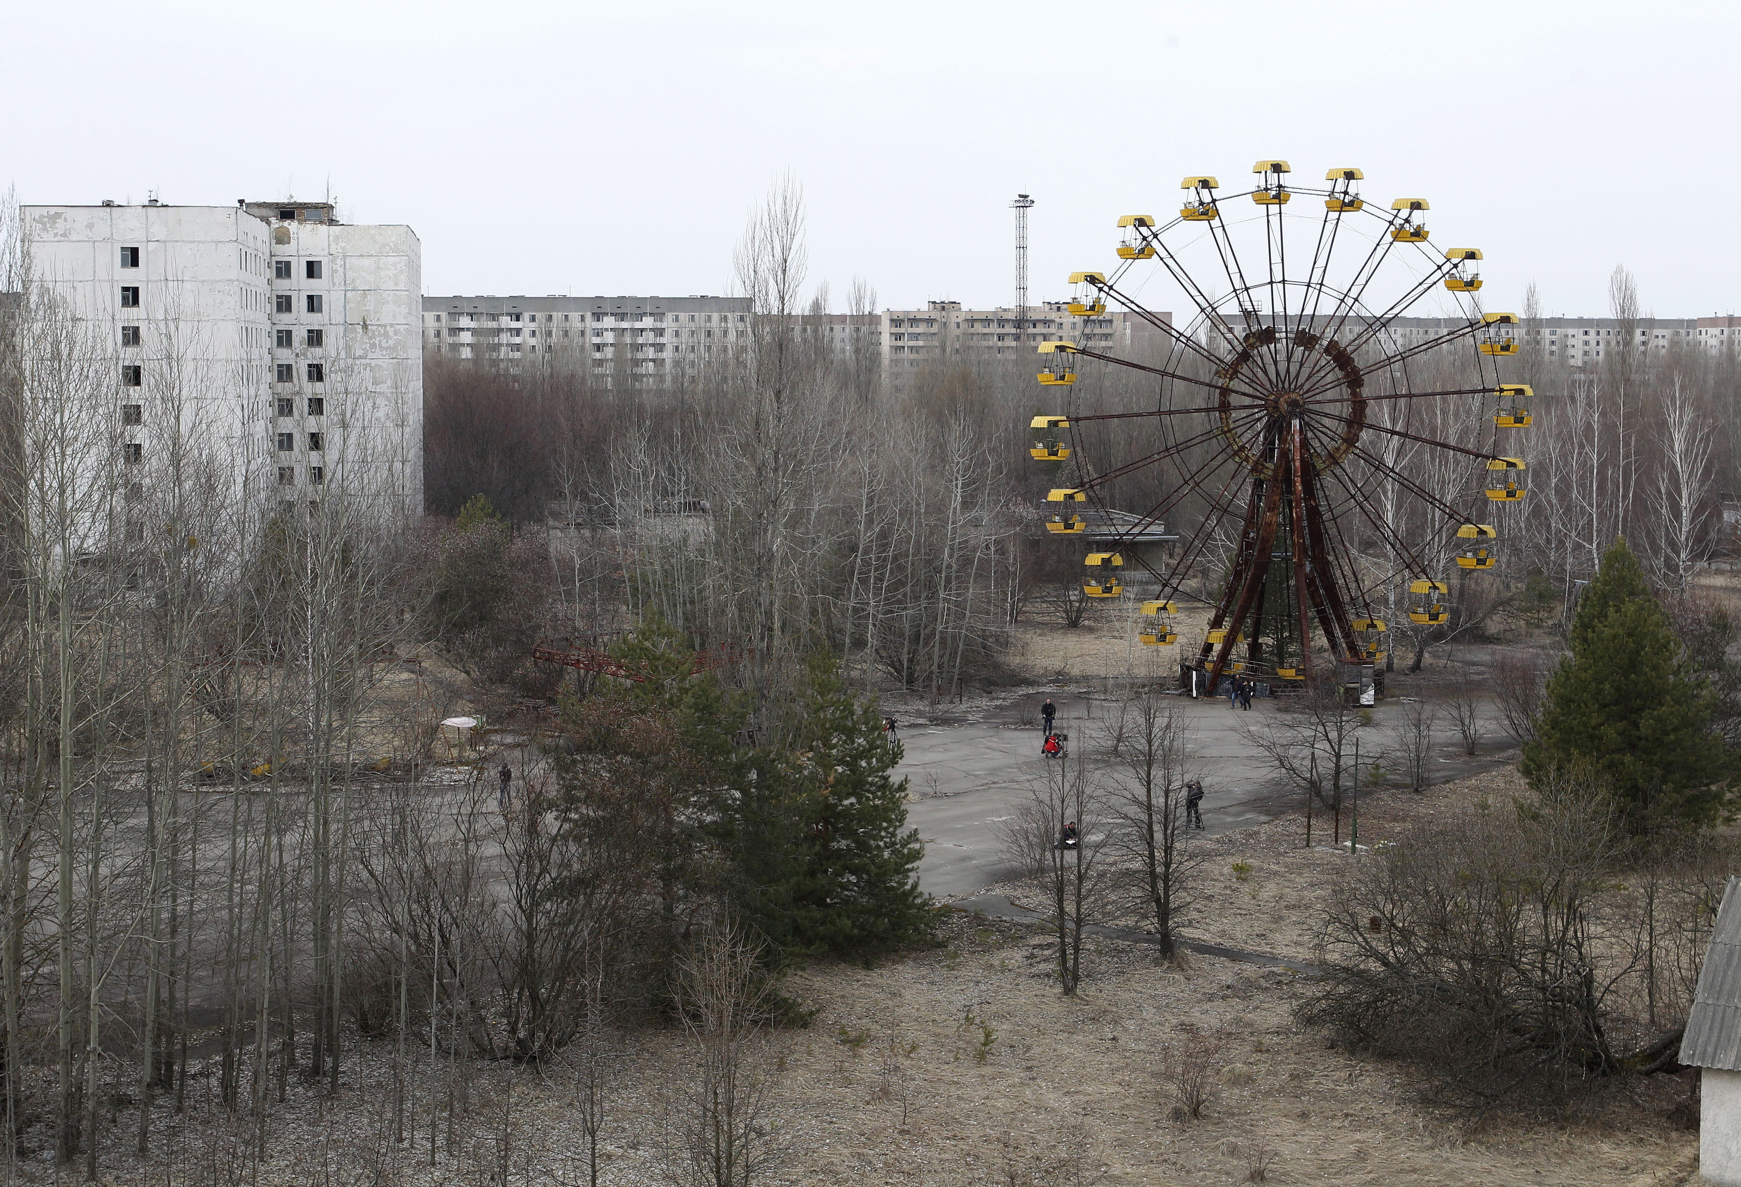

Introduction
Nuclear reaction occurs when an unstable nucleus undergoes nuclear decay in order to attain a stable state. The stability of a nucleus depends upon the constituent neutrons and protons. Increasing number of neutron and protons results in an unstable nucleus.
Binding Energy:
“The energy required to disperse or separate a nucleus into it’s constituent neutrons and protons is known as binding energy”.
The difference in mass of the nuclei so formed is equal to the binding energy and is given by,
B.E=Δmc2
One of the most common form of nuclear fission of them is U-235.
${}_{92}^{235}U+\text{ή}→{}_{36}^{92}kr+{}_{56}^{141}{Ba}$ + 3ή

Slide 3
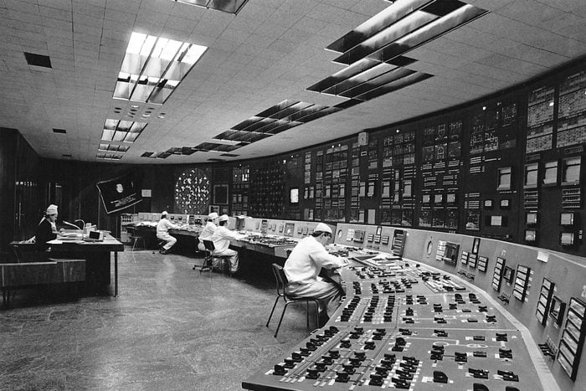
Introduction
Uranium is a unique element that belongs to Acthides group. It exhibits properties of luminescence and radioactivity. It is highly abundant It has a half life of 71.3 Million years.
There are in total about 422 operational fission reactors in the world (source IAEA) from which more than 99% are Uranium reactors. When completely fissioned, 1 mol of U-235 produces about 18 Terra Joules of Energy.

Slide 4
Timeline
Henri Bercquerel Discover radioactivity
1896
Chicago Pile-1, USA 1942
Trinity, USA 1945
First Nuclear test
Radiocativity was discovered
First Ever Nuclear reactor
IAEA, UN 1957
IAEA was established.
Trombay, INDIA 1954
APSARA, India’s first nuclear reactor

Slide 5
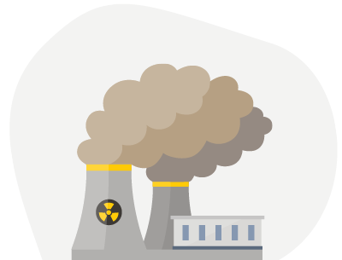
3-Mile Island, USA 1979
Chernobyl, USSR 1896
Partial meltdown & radiation leakage
Nuclear explosion & complete nuclear meltdown
Nuclear Fusions
Smiling Buddha, INDIA 1974
India’s first nuclear test.
Fukushima Daichi, JAPAN 2011
Partial nuclear meltdown
20??

Slide 6
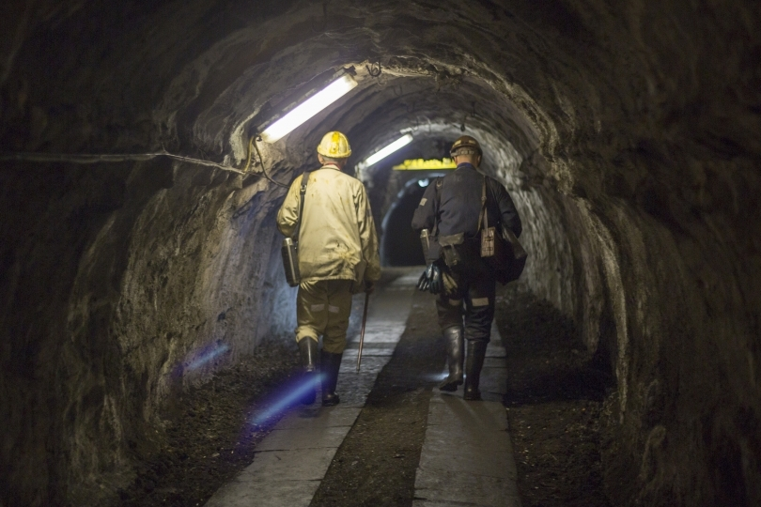
Includes:
Uranium is mined along with other impurities from it’s ore.
Uranium is them milled into ’Yellow cake’. Yellow is later converted into UO2 and then into UF6 gas
UF6 gas is then enriched in large centrifuges (typically about 60-70% U235) to increase conc. of U-235 .
UF6 is converted back into UO2 and made into ceramic fuel pallets
Uranium pallets are cautiously stored before loading into the fuel rods to be used in reactors.
The used-up fuel is then reprocessed in underground repositories for the disposal of nuclear waste.
Extraction
& Enrichment

Slide 7
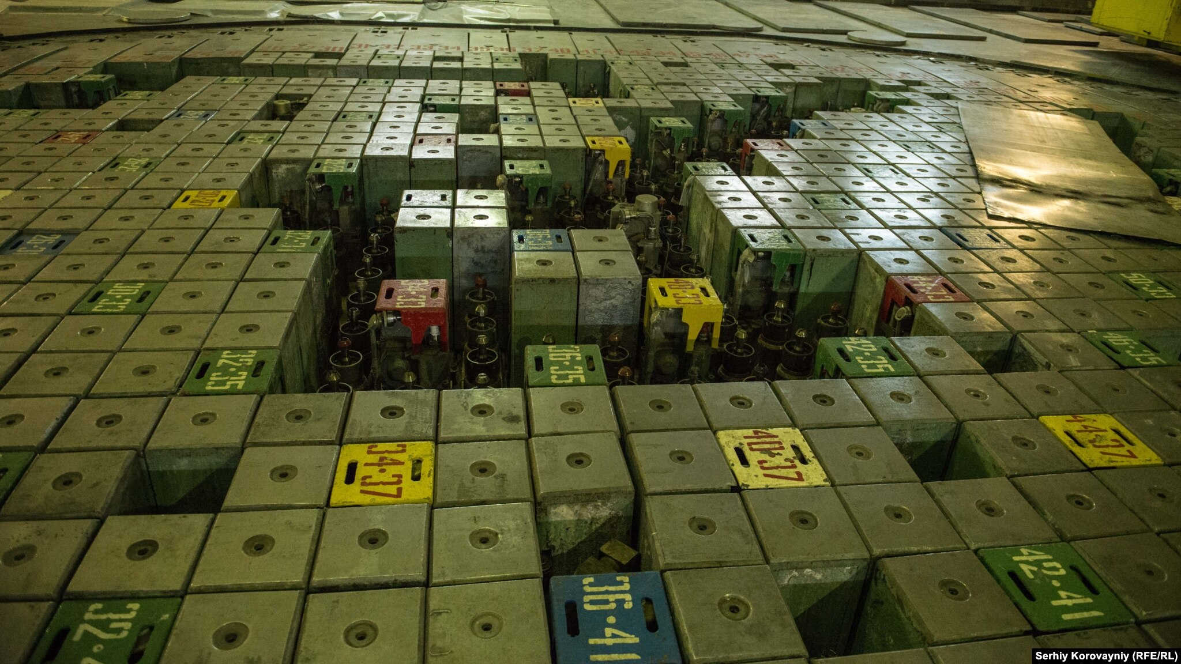
A reactor consists of
Control rods: Control rod bundles provide a rapid means of controlling chain reactions. Control rods are made of neutron absorbing materials and typically have the same dimensions as the fuel elements.
Fuel rods-They are the containment vessel that houses the fuel element. Nuclear fuel is a material capable of fissioning sufficiently to reach critical mass, that is, to sustain a nuclear chain reaction.
Coolant- The function of the coolant is to absorb this thermal energy and transport it.
Neutron mediators-The function of the moderator is to reduce the kinetic energy of the neutrons through elastic collisions of the neutrons with the nuclei of the moderator itself.
REACTOR

Slide 8
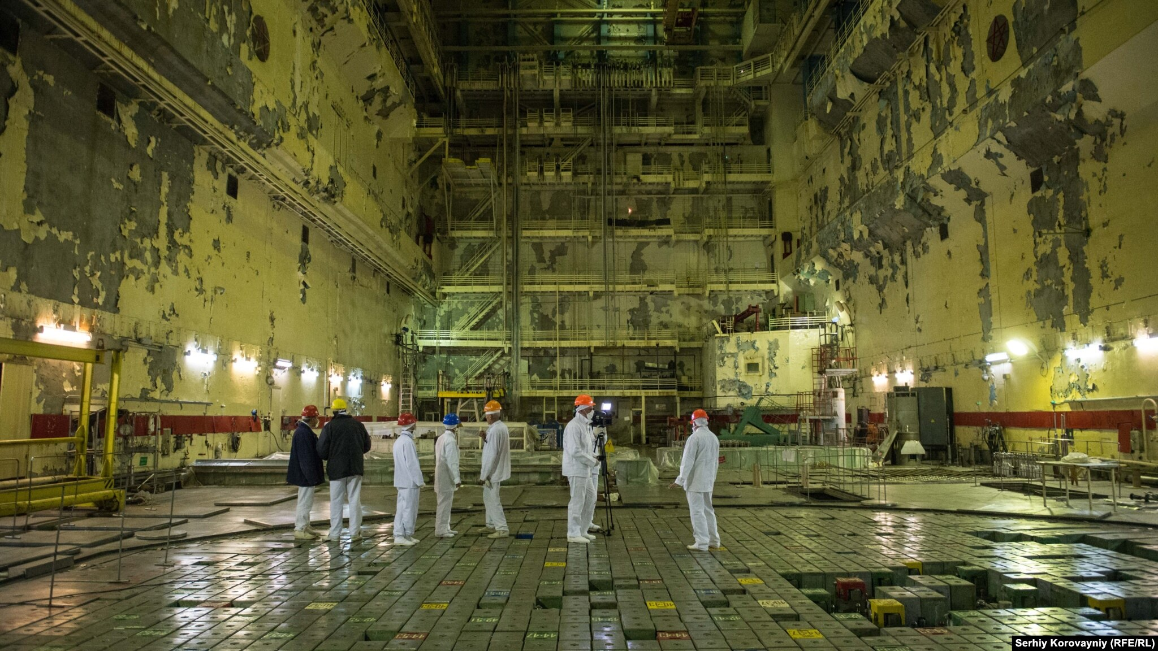
REACTOR
Powering core- The core is powered by fuel rods containing nuclear fuel. Neutron source provides the neutron required for starting the self-sustaining chain reaction.
Controlling chain reaction- Control rods are used to control of the nuclear chain reaction. Control rod are inserted into the reactor which absorbs excess neutrons slowing down the nuclear chain reaction.
Refueling- The used fuel is removed once it’s completely depleted, and fuel pallets are added into the fuel rod. While the used fuel is sent to be disposed or repurposing.

Slide 9
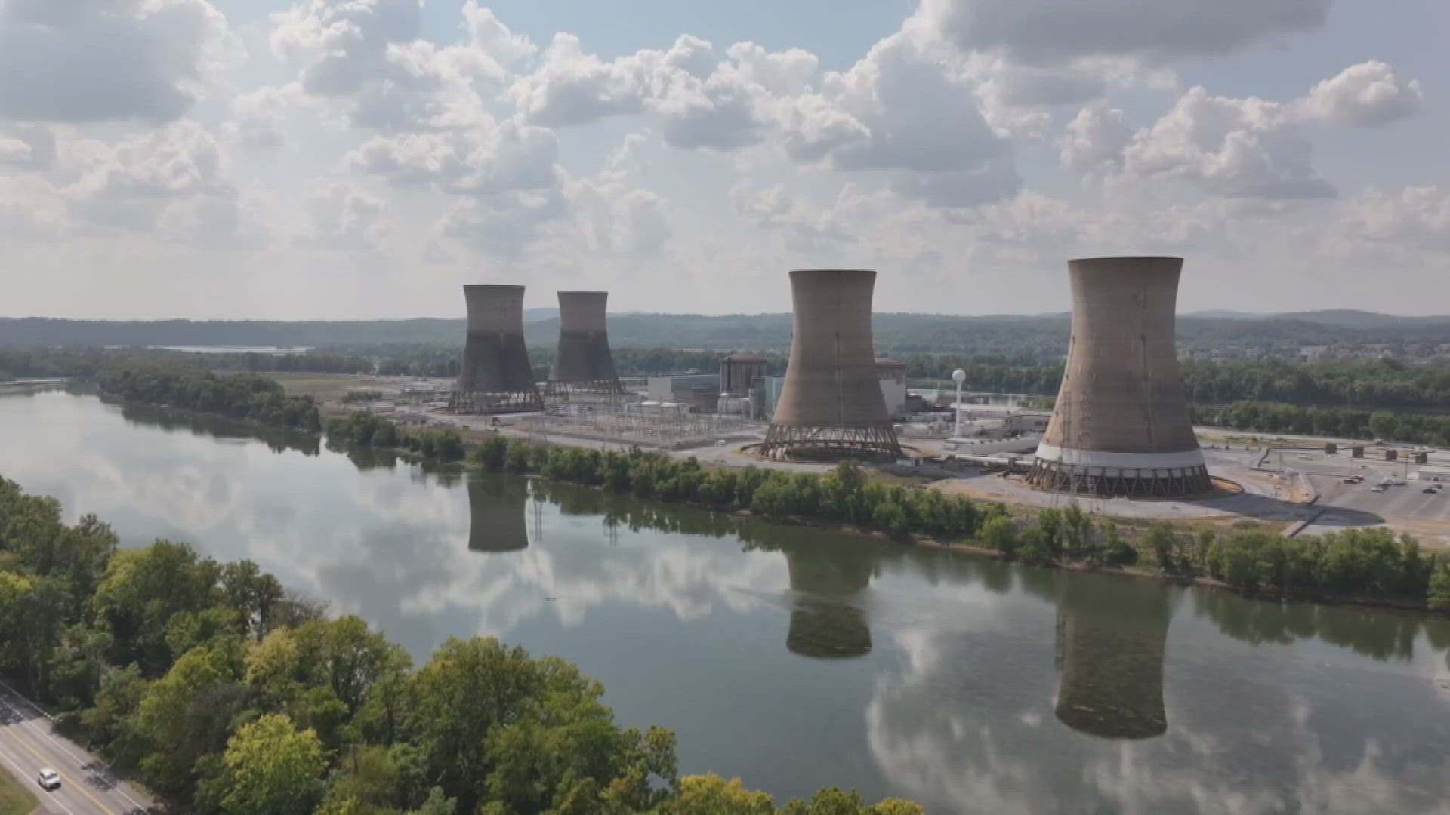
Nuclear safeguards
The Nuclear power plant is localized in remote region due to the risks associated. The containment building is the last of several safeguards that prevent the release of radioactivity to the environment. A containment building is a reinforced steel, concrete or lead structure enclosing a nuclear reactor. It is designed, in any emergency, to contain the escape of radioactive steam or gas. The containment is the fourth and final barrier to radioactive release, the first being the fuel ceramic itself, the second being the metal fuel cladding tubes, the third being the reactor vessel and coolant system. The only recorded event of damage to a nuclear containment building is the Chernobyl disaster where the blast was strong enough to blow the upper casing of the reactor through the containment building. It caused a nuclear element infused fire that burned for months due the graphite . Blowing radioactive debris over a 100-mile radius.

Slide 10



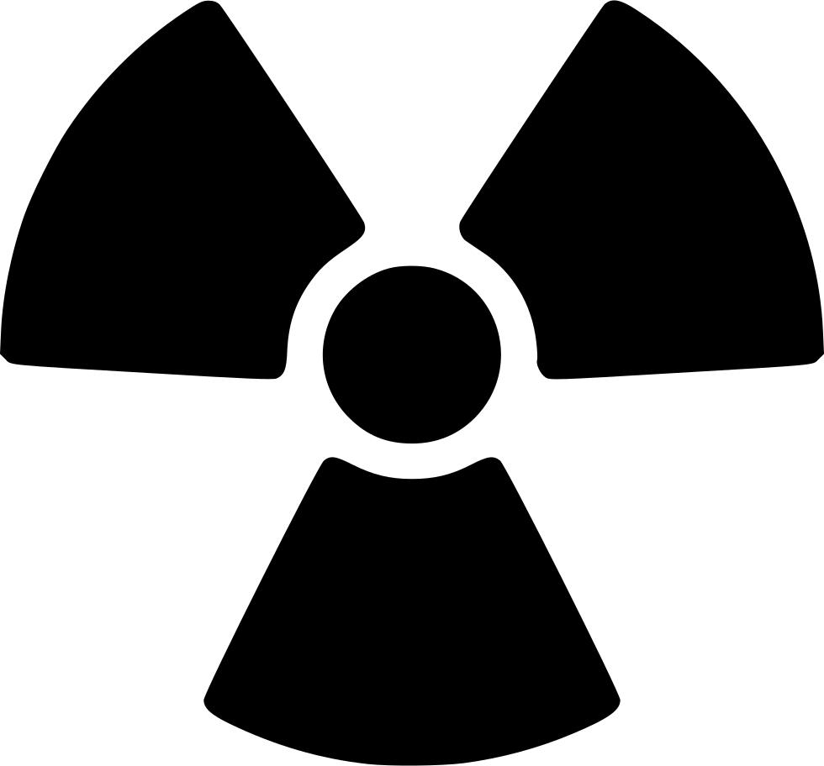

URANIUM AS
Energy efficiency comparison
x565 Liters
x480 cm³
of oil
of gas
5g of
²³⁵U
=
ΔE_{(1 U – 235)} = 3.195 × 10^{–11} J
x1000 Kg
of coal
A CLEAN FUEL

Slide 11
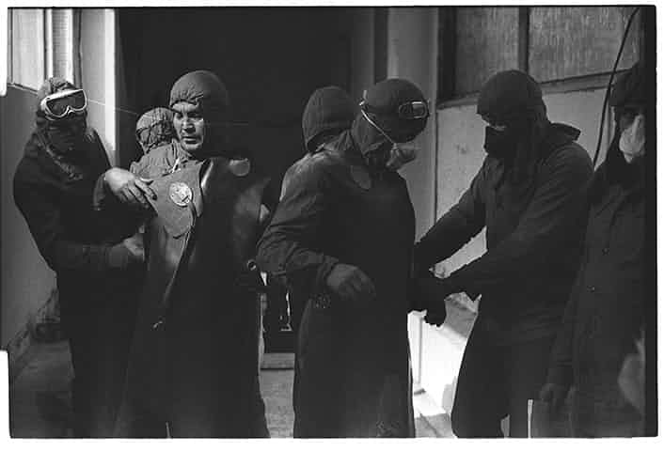
Hazards of nuclear Energy
Nuclear Meltdown- One of the downsides of using a solid-state nuclear fuel is that, if due to some reason the cooling system fails, the heat produced due to the chain reaction starts melting the fuel rods making them unoperatable.
Contamination & leakage- Possible Contamination and radiation leakage may have devastating consequences . (The cleanup of which could take serval decades as well as could cost plenty of life and resources. It could even yield the affected area inhospitable for years to come).
Accelerated risks of genetic mutation- It could increase the risk of genetic mutation and radiation induced painful death within minutes of exposure.

Slide 12
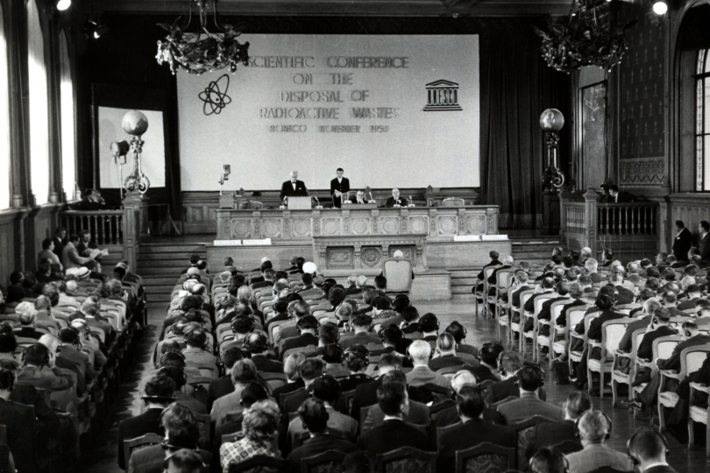
Nuclear Waste
One of the key challenges faced is that even when the nuclear fuel is all used up it is radioactive and emits extreme amount of radiation through the years of the half of life. Hence, it needs to be separately processed and contained for disposal.
Used up fuel needs to be carefully disposed in a manner that it does not vent radiation into the surrounding. Failing to properly dispose nuclear waste risks it’s introduction into
Undisposed nuclear waste can also be used to develop a biological weapon in form of a ‘dirt bomb’.

Slide 13
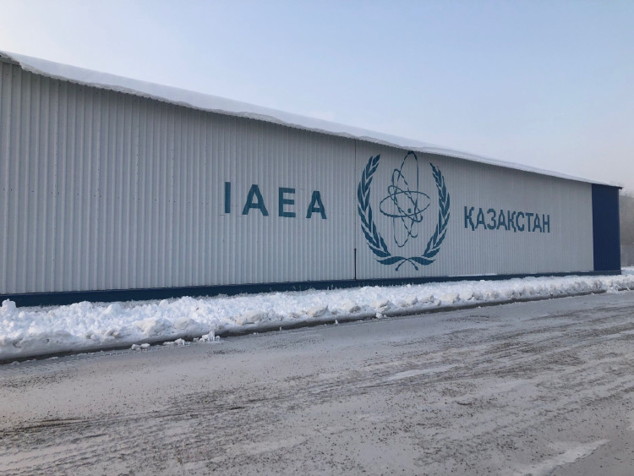
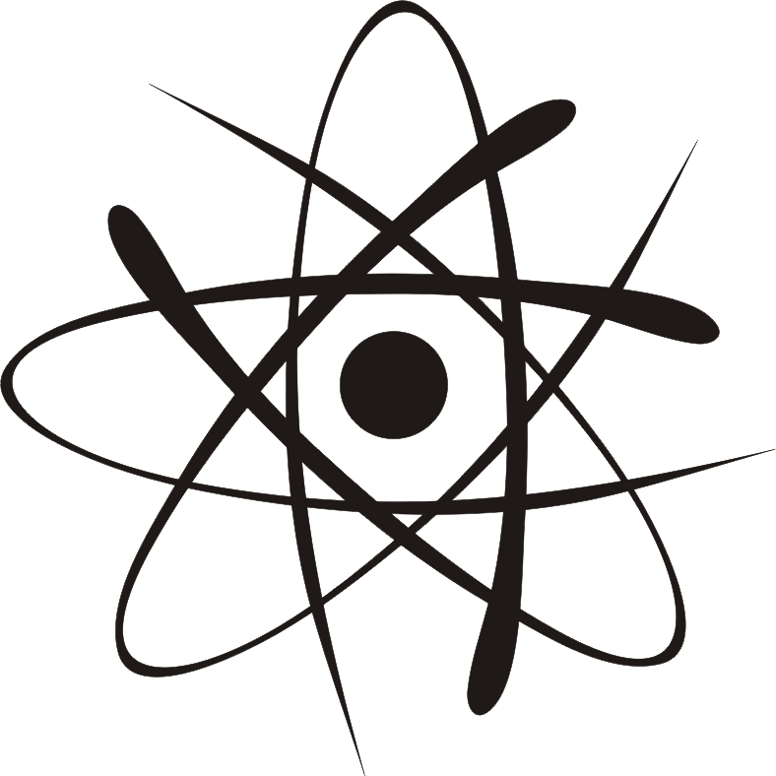
IAEA
The IAEA or the International Atomic Energy Agency is an organization working for increasing nuclear co-operation. It was established prevent nuclear proliferation, has specific roles as the international safeguards inspectorate and as a multilateral channel for transferring peaceful applications of nuclear technology. The IAEA conducts regular inspection of enrichment sites and nuclear powerplant to check specified nuclear protocols are being followed.

Slide 14
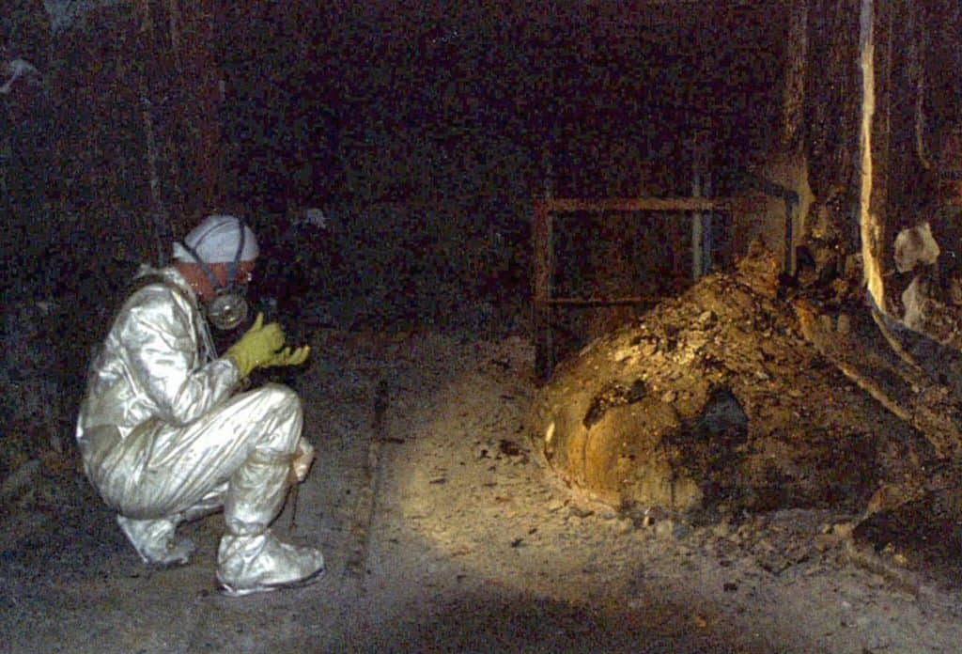
QUESTIONS?

Slide 15

Thank You

